Slide 1

Three parameters to represent sine wave
Peak Amplitude
Frequency
Phase
Frequency and period are the inverse of each other.

Slide 2

Table 1.1 Units of period and frequency

Slide 3

Example 1.1
The power we use at home has a frequency of 60 Hz. The period of this sine wave can be determined as follows:

Slide 4

Example 1.2
The period of a signal is 100 ms. What is its frequency in kilohertz?
Solution
First we change 100 ms to seconds, and then we calculate the frequency from the period (1 Hz = 10⁻³ kHz).

Slide 5
Bandwidth
The bandwidth of a composite signal is the difference between the
highest and the lowest frequencies contained in that signal.

Slide 6

Figure 1.11 The bandwidth of periodic and non-periodic composite signals

Slide 7

Example 1.3
If a periodic signal is decomposed into five sine waves with frequencies of 100, 300, 500, 700, and 900 Hz, what is its bandwidth? Draw the spectrum, assuming all components have a maximum amplitude of 10 V.
Solution
Let f_{h} be the highest frequency, f_{l} the lowest frequency, and B the bandwidth. Then

Slide 8
Example 1.4
A periodic signal has a bandwidth of 20 Hz. The highest frequency is 60 Hz. What is the lowest frequency? Draw the spectrum if the signal contains all frequencies of the same amplitude.
Solution
Let f_{h} be the highest frequency, f_{l} the lowest frequency, and B the bandwidth. Then

Slide 9
Example 1.6
A digital signal has eight levels. How many bits are needed per level? We calculate the number of bits from the formula
Each signal level is represented by 3 bits.

Slide 10
Bit rate
Bit rate is used to describe digital signals (instead of frequency)
It is the number of bits sent in 1 second, expressed in bits per second (bps).
Example 1.7
Assume we need to download text documents at the rate of 100 pages per minute. What is the required bit rate of the channel?
Solution
A page is an average of 24 lines with 80 characters in each line. If we assume one character requires 8 bits, the bit rate is
100 * 24 * 80 * 8 = 1,536,000bps = 1.536 Mbps

Slide 11
Bit Length
(as like wavelength for analog signal)
Bit length is the distance one bit occupies on the transmission medium
Bit length = propagation speed * bit duration

Slide 12

1.4 TRANSMISSION IMPAIRMENT
Signals travel through transmission media, which are not perfect. The imperfection causes signal impairment. This means that the signal at the beginning of the medium is not the same as the signal at the end of the medium. What is sent is not what is received.

Slide 13
Attenuation
Attenuation means a loss of energy.
When a signal, simple or composite, travels through a medium, it loses some of its energy in overcoming the resistance of the medium. That is why a wire carrying electric signals gets warm.
Some of the electrical energy in the signal is converted to heat. To compensate for this loss, amplifiers are used to amplify the signal.

Slide 14

Figure 1.21 Attenuation

Slide 15
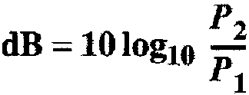
Decibel
To show that a signal has lost or gained strength, engineers use the unit of the decibel.
The decibel (dB) measures the relative strengths of two signals or one signal at two different points.
If the decibel is negative if a signal is attenuated and positive if a signal is amplified.

Slide 16

Example 1.8
Suppose a signal travels through a transmission medium and its power is reduced to one-half. This means that P2 is (1/2)P1. In this case, the attenuation (loss of power) can be calculated as
A loss of 3 dB (–3 dB) is equivalent to losing one-half the power.

Slide 17


Example 1.9
A signal travels through an amplifier, and its power is increased 10 times. This means that P₂ = 10P₁ . In this case, the amplification (gain of power) can be calculated as

Slide 18
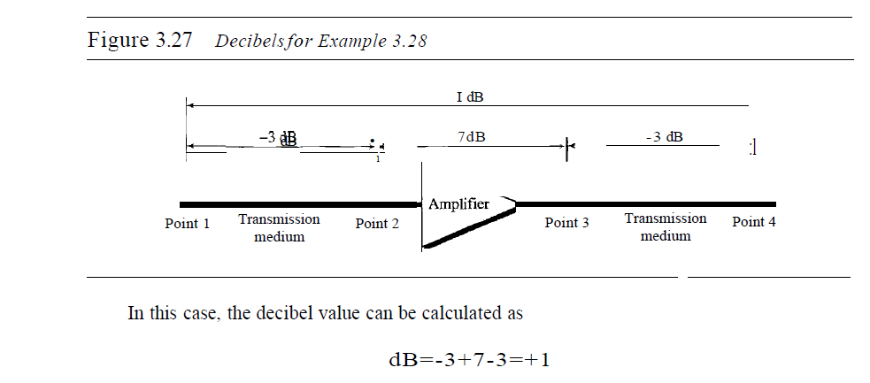
3.<number>

Slide 19
Distortion
Distortion means that the signal changes its form or shape.
Distortion can occur in a composite signal made of different frequencies.
Each signal component has its own propagation speed through a medium and, therefore, its own delay in arriving at the final destination.
Signal components at the receiver have phases different from what they had at the sender.
The shape of the composite signal is therefore not the same.

Slide 20

Figure 1.22 Distortion

Slide 21
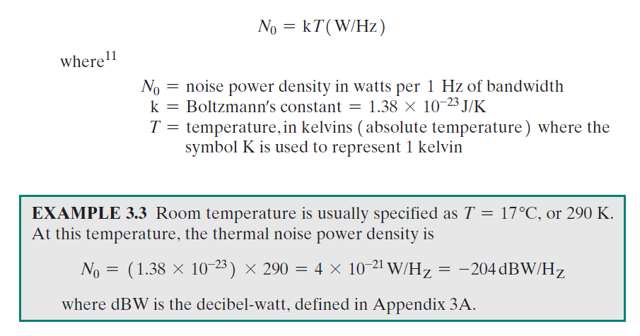
Noise
Several types of noise, such as thermal noise, induced noise, crosstalk, and impulse noise, may corrupt the signal.
Thermal noise is the random motion of electrons in a wire which creates an extra signal not originally sent by the transmitter.
Induced noise comes from sources such as motors and appliances. These devices act as a sending antenna, and the transmission medium acts as the receiving antenna.

Slide 22
Crosstalk is the effect of one wire on the other. One wire acts as a sending antenna and the other as the receiving antenna.
Impulse noise is a spike (a signal with high energy in a very short time) that comes from power lines, lightning, and so
on.
3.<number>

Slide 23

Figure 1.23 Noise
3.<number>

Slide 24
Signal-to-Noise Ratio (SNR)
The signal-to-noise ratio is defined as
SNR=average signal power
average noise power
SNR is actually the ratio of what is wanted (signal) to what is not wanted (noise).
A high SNR means the signal is less corrupted by noise; a low SNR means the signal is more corrupted by noise.
SNR is the ratio of two powers, it is often described in decibel units, SNR_{dB}, defined as
SNR_{dB} = 10log₁₀ SNR

Slide 25

Figure 1.24 Two cases of SNR: a high SNR and a low SNR

Slide 26
1.5 DATA RATE LIMITS
A very important consideration in data communications is how fast we can send data, in bits per second, over a channel. Data rate depends on three factors:
1. The bandwidth available
2. The level of the signals we use
3. The quality of the channel (the level of noise)
3.<number>

Slide 27
Two theoretical formulas were developed to calculate the data rate: one by Nyquist for a noiseless channel, another by Shannon for a noisy channel.
Noiseless Channel: Nyquist Bit Rate
For a noiseless channel, the Nyquist bit rate formula defines the theoretical maximum bit rate
BitRate = 2 x bandwidth x 10g2 L
Bandwidth of the channel
L number of signal levels used to represent data
3.<number>

Slide 28
Example 1.10
Consider a noiseless channel with a bandwidth of 3000 Hz transmitting a signal with two signal levels. The maximum bit rate can be calculated as

Slide 29
Example 1.11
Consider the same noiseless channel transmitting a signal with four signal levels (for each level, we send 2 bits). The maximum bit rate can be calculated as
3.<number>

Slide 30
Noisy Channel: Shannon Capacity
In reality, we cannot have a noiseless channel; the channel is always noisy.
In 1944, Claude Shannon introduced a formula, called the Shannon capacity, to determine the theoretical highest data rate for a noisy channel:
Capacity =bandwidth X log₂ (1 +SNR)

Slide 31
Example 1.12
Consider an extremely noisy channel in which the value of the signal-to-noise ratio is almost zero. In other words, the noise is so strong that the signal is faint. For this channel the capacity C is calculated as
This means that the capacity of this channel is zero regardless of the bandwidth. In other words, we cannot receive any data through this channel.

Slide 32
Example 1.13
We can calculate the theoretical highest bit rate of a regular telephone line. A telephone line normally has a bandwidth of 3000. The signal-to-noise ratio is usually 3162. For this channel the capacity is calculated as
This means that the highest bit rate for a telephone line is 34.860 kbps. If we want to send data faster than this, we can either increase the bandwidth of the line or improve the signal-to-noise ratio.

Slide 33
1.6 PERFORMANCE
One important issue in networking is the performance of the network—how good is it?
In networking, we use the term bandwidth in two contexts.
❏ The first, bandwidth in hertz, refers to
the range of frequencies in a
composite signal or the range of
frequencies that a channel can pass.
❏ The second, bandwidth in bits per
second, refers to the speed of bit
transmission in a channel or link.

Slide 34
In networking, we use the term bandwidth in two contexts.
❏ The first, bandwidth in hertz, refers to
the range of frequencies in a
composite signal or the range of
frequencies that a channel can pass.
❏ The second, bandwidth in bits per
second, refers to the speed of bit
transmission in a channel or link.

Slide 35
Throughput
The throughput is a measure of how fast we can actually send data through a network.
Although, at first glance, bandwidth in bits per second and throughput seem the same, they are different.
Imagine a highway designed to transmit 1000 cars per minute from one point to another. However, if there is congestion on the road, this figure may be reduced to 100 cars per minute. The bandwidth is 1000 cars per minute; the throughput is 100 cars
per minute.

Slide 36
Example 1.14
A network with bandwidth of 10000 Mbps can pass only an average of 12000 frames per minute with each frame carrying an average of 10000 bits. What is the throughput of the system?
Solution
Throughput = (12000 * 10000) / 60 = 2 Mbps
Throughput is almost one-fifth of the bandwidth
3.<number>

Slide 37
Latency (Delay)
The latency or delay defines how long it takes for an entire message to completely arrive at the destination from the time the first bit is sent out from the source.
We can say that latency is made of four components:
propagation time, transmission time, queuing time and processing delay.
Latency =propagation time +transmission time +queuing time
+ processing delay

Slide 38
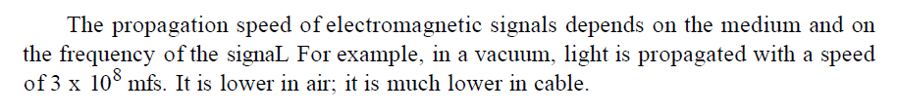
Propagation Time:
Propagation time measures the time required for a bit to travel from the source to the
destination.
Assume the propagation speed to be 2.4 x 10⁸ m/s in cable.
Propagation time = Distance
Propagation speed

Slide 39
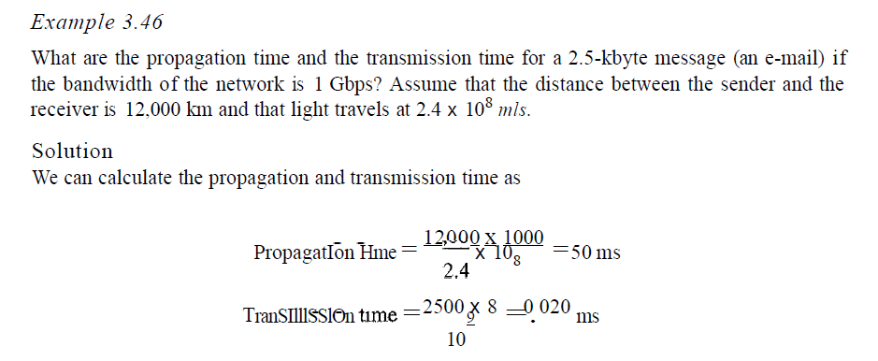
Transmission time
In data communications we don't send just 1 bit, we send a message. The first bit may take a time equal to the propagation time to reach its destination; the last bit also may take the same amount of time. However, there is a time between the first bit leaving the sender and the last bit arriving at the receiver. The first bit leaves earlier and arrives earlier; the last bit leaves later and arrives later. The time required for transmission of a message depends on the size of the message and the bandwidth of the channel.
Transmission time =Message size
Bandwidth
3.<number>

Slide 40

The bandwidth-delay product defines the number of bits that can fill the link.
Figure 1.25 Concept of bandwidth-delay product
The cross section of the pipe represents the bandwidth, and the length of the pipe represents the delay. We can say the volume of the pipe defines the bandwidth-delay product

Slide 41
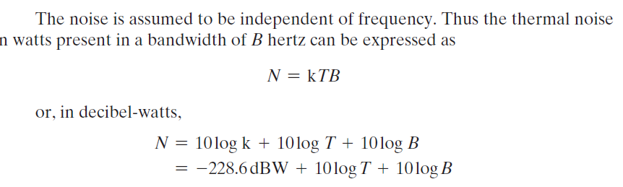
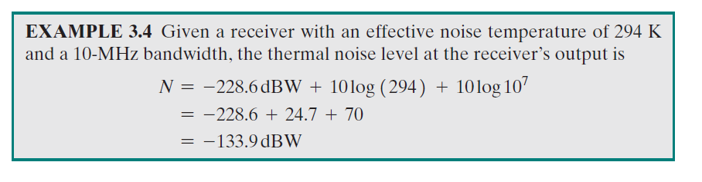
Example for thermal Noise from Stallings book…additional
3.<number>

Slide 42
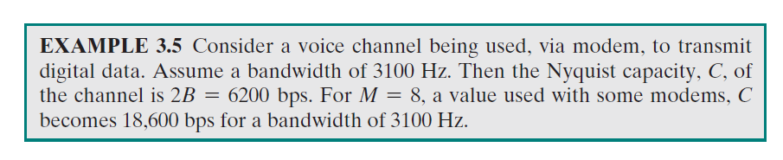
3.<number>

Slide 43
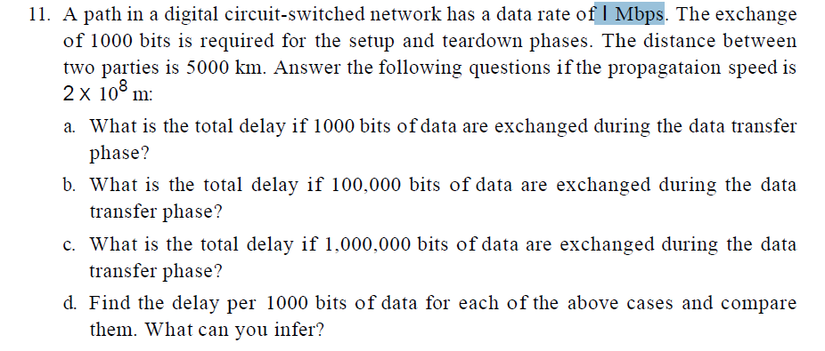
3.<number>

Slide 44
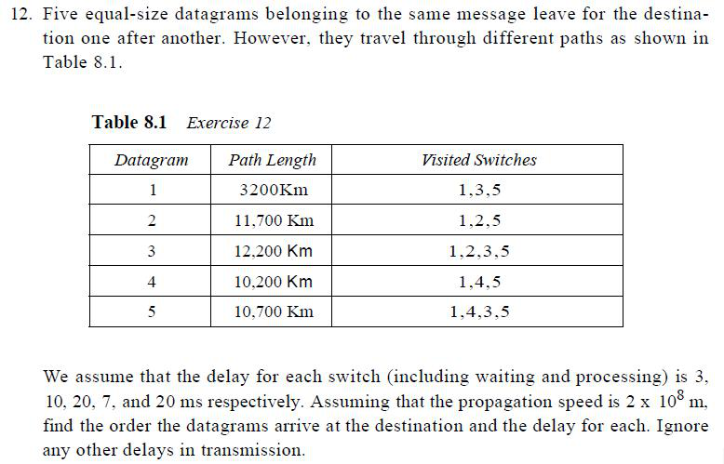
3.<number>

